Slide 1
CS4499/5599: Data Science and Applied Machine Learning
Class Lecture: April 10th, 2023

Slide 2
Objectives
Last time:
Different approaches for multi-class Logistic Regression
Training machine learning models with k-Nearest Neighbors
Today:
Machine Learning with Naïve Bayes
Machine Learning with Support Vector Machines
Introduce unsupervised learning (if time permits)

Slide 3
Naïve Bayes
Like logistic regression, Naïve Bayes is a probabilistic machine learning approach, i.e., we will calculate probabilities of our sample belonging to a class and choose the largest one
There have been several papers written about using Naïve Bayes for regression, but it is almost always exclusively used as a classifier
Naïve Bayes can be used for both binary and multi-class classification
However, a key difference between the two methods is that Naïve Bayes assumes statistical independence between our features (logistic regression assumes the opposite)

Slide 4
Statistical Independence
Statistical independence simply means that the occurrence of an event will not impact the probability of another event occurring
For example, if we were to flip a balanced coin, we know there is a 50% probability it will come up heads, now if I flip it again, what is the probability of the next flip being heads?
The result of the second flip is not impacted by the result of the first
Therefore, each coin flip is considered statistically independent

Slide 5
Statistical Independence
Now consider a standard deck of cards (52 cards, 4 suits for each value, etc.)
What is the probability that we draw a card of a specific value?
Now assume we draw that value from the deck and do not replace it, now what is the probability to draw the same value from the deck
Each draw affects the composition of the deck and the probability changes with each draw (regardless of what value we draw)

Slide 6
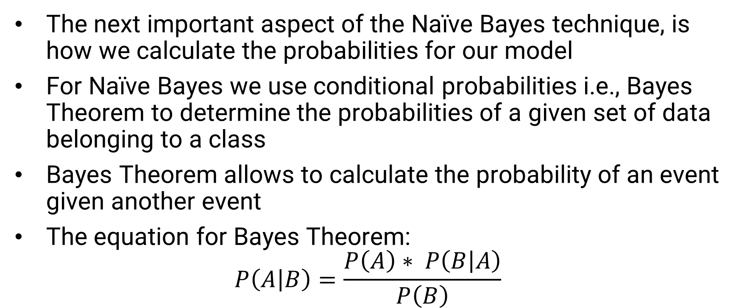
Bayes Theorem
The next important aspect of the Naïve Bayes technique, is how we calculate the probabilities for our model
For Naïve Bayes we use conditional probabilities i.e., Bayes Theorem to determine the probabilities of a given set of data belonging to a class
Bayes Theorem allows to calculate the probability of an event given another event
The equation for Bayes Theorem:
$$P\left(A | B\right)=\frac{P\left(A\right)∗ P\left(B | A\right)}{P\left(B\right)}$$

Slide 7
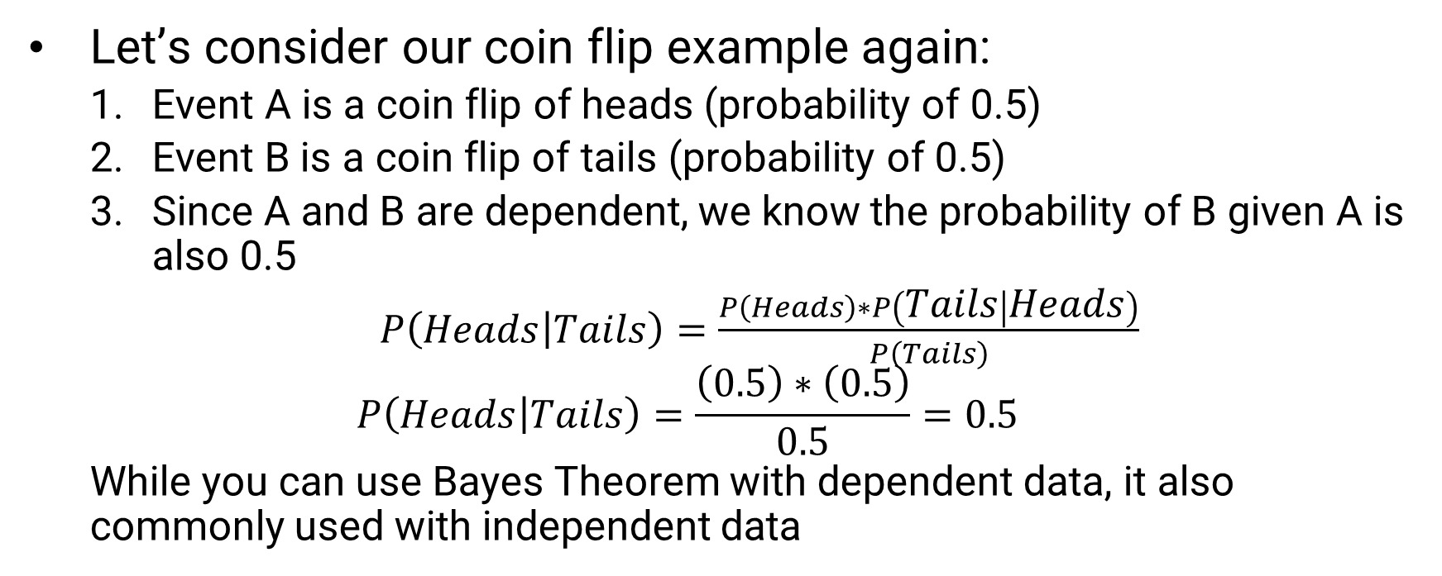
Bayes Theorem Example
Let’s consider our coin flip example again:
Event A is a coin flip of heads (probability of 0.5)
Event B is a coin flip of tails (probability of 0.5)
Since A and B are dependent, we know the probability of B given A is also 0.5
$P\left(Heads | Tails\right)=\frac{P\left(Heads\right)∗P\left(Tails | Heads\right)}{P\left(Tails\right)}$
$$P\left(Heads | Tails\right)=\frac{\left(0.5\right)∗\left(0.5\right)}{0.5}=0.5$$
While you can use Bayes Theorem with dependent data, it also commonly used with independent data

Slide 8

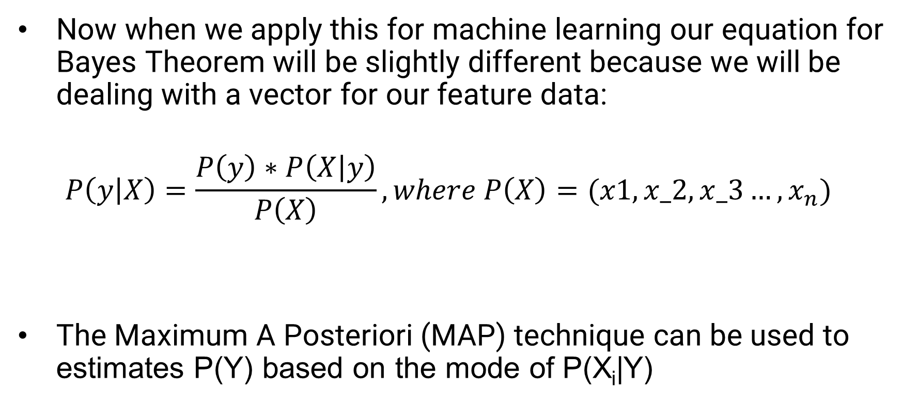
Naïve Bayes Classifier
Now when we apply this for machine learning our equation for Bayes Theorem will be slightly different because we will be dealing with a vector for our feature data:
$$P\left(y | X\right)=\frac{P\left(y\right)∗P\left(X | y\right)}{P\left(X\right)}, where P\left(X\right)=(x1, x_2, x_3…, x_{n})$$
The Maximum A Posteriori (MAP) technique can be used to estimates P(Y) based on the mode of P(X_{i}|Y)

Slide 9



Naïve Bayes Forms
The Naïve Bayes classifier comes in three forms, the difference is the equation used to calculate P(X_{i} |Y):
Gaussian Distribution, where the data is continuous and behaves in a normal distribution
Bernoulli Distribution, where our data is binary/Boolean form
Multinominal Distribution, a generalized form of the Bernoulli Distribution, where feature vectors represent the frequencies of occurrence

Slide 10
Naïve Bayes Example
Unlike kNN and decision trees we can’t really visualize a Naïve Bayes classifier
However, there are several examples that can be used to demonstrate how Naïve Bayes works
The classic application for Naïve Bayes is an email spam detector
For our spam detector, we would train our model on emails we have received previously, the words within the email will be our feature data and the spam/ not spam would our target

Slide 11

Naïve Bayes Example
Using our training data, the algorithm will detect the probability that an email containing certain words will be spam
Common words like “this” and “it” will likely be assigned neutral probabilities and will not have an impact on the classification
All the probabilities are calculated using Bayes Theorem, the equation would look something like this:
The probabilities can be updated as more emails are received

Slide 12
Naïve Bayes Pros/Cons
Prior to the resurgence in interest in recurrent neural networks (RNNs), Naïve Bayes was the most popular approach for text classification and natural language processing (NLP)
Although RNNs have taken over this field of study Naïve Bayes Models still have several advantages:
Can be mathematically explained using probabilities
Simple to implement
Extremely fast to train the models
Flexible with types of Data
Doesn’t require a lot of data
Few if any hyperparameters to tune

Slide 13
Naïve Bayes
The main disadvantage so Naïve Bayes is the assumption of statistical independence
This in rare in real life, so you need to be careful what data you use with this model
Some in machine learning will say it is an outdate technique, but it still does see use in both industry and research
Sklearn has support for all three Naïve Bayes Classifiers
sklearn.naive_bayes.GaussianNB
sklearn.naive_bayes.MultinomialNB
sklearn.naive_bayes.BernoulliNB (The class will automatically put your data in binary form)

Slide 14
Support Vector Machines
Support Vector Machines (SVM) is one of the most popular supervised machine learning techniques in use today
SVM is a very versatile approach that can be used in both regression and classification
SVM is best suited for use with small and medium sized datasets
SVM is similar to kNN, DTs and logistic regression where we will use a decision boundary to separate our classes
The key difference is that SVM uses a straight line for the decision boundary (referred to as linearly separable)

Slide 15
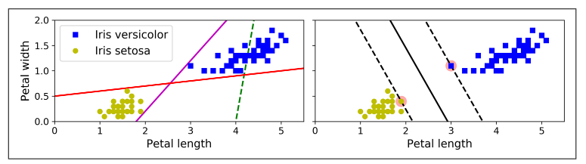
Support Vector Machines
Consider this figure from Geron:
What are some issues with the three classifiers on the left?
The graph on the right represents a SVM classifier and you will notice there is a large gap between the instances and the decision boundary

Slide 16
Support Vector Machines
Consider this figure from Geron:
The two highlighted instances, are known as support vectors
These are the two datapoints closest to our decision boundary (also known as the hyperplane)

Slide 17
Forms of SVM Classification
When preforming “linear” classification, we two rules we can impose for our model:
Hard margin classification
Soft margin classification
With hard margin, we strive to keep data points off the gap between the support vectors and the hyperplane
When working with a hard margin the classification is extremally sensitive to outliers
This only works if our data is linearly separable

Slide 18
Soft Margin Classification
Soft Margin classification allows our model to be more flexible
Our goal is to balance the distance between support vectors, with the number of violators (points between the SV and the hyperplane)
One of the most important hyperparameters for this type of classification is known as the C value (or just C)
C allows us to control the distance between support vectors, a high value of C means a smaller distance (and lower number of violators) and a lower C means the opposite

Slide 19
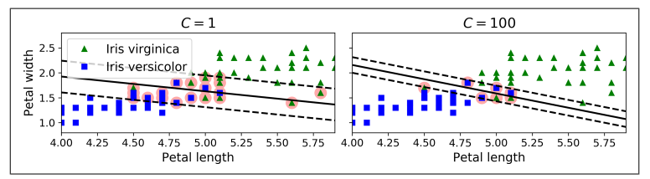
Soft Margin Classification
A high C value also increases the chances your model will be overfit
Although violators are considered bad, the model on the left (more prone to misclassifications) will likely generalize better than the one on the right

Slide 20
Nonlinear SVM Classification
Linear SVM is a very efficient approach for training a machine learning model
However, many dataset are not linearly separable, there are two commons ways we can deal with this:
We can use a polynomial kernel (a hyper parameter we can specify)
We can implement a similarity function using a Gaussian Radial Basis Function (RBF) (again we specify this with the kernel hyperpameter)
Note that a kernel method will add a high degree of complexity to your algorithm (typically O(n² )to O( n³ ))

Slide 21
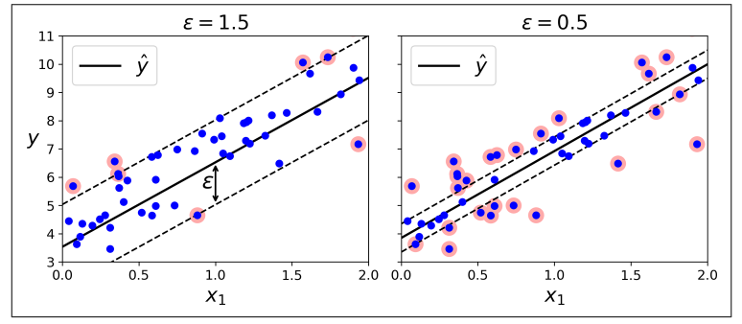
SVM Regression
As mentioned, SVM can also be used to train regression models
Instead of limiting the number of instances between the support vectors, we want as many instances as possible in between

Slide 22
SVM Regression
The width between the support vectors is controlled by the hyper parameter ε
With regression, adding new instances will not affect our model’s performance, so the model is considered ε-insensitive
Just as was the case with classification, if a linear model doesn’t fit your data, you can use a kernel to try and address this issue
However, remember using a kernel like RFB will introduce more complexity to your model and require more computation time

Slide 23
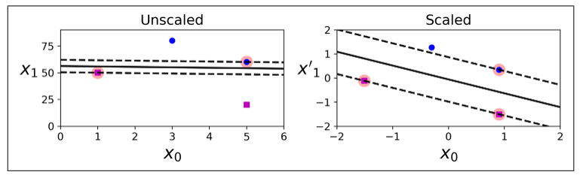
Feature Scaling with SVM
SVM models are very sensitive to feature scaling, without scaling you will notice a big difference in the quality of your models

Slide 24
Sklearn SVM Classes
Sklearn has several classes you can use to train SVM models
For linear SVM models you can use:
sklearn.svm.SVC (good for smaller datasets)
sklearn.svm.LinearSVC (scales better for larger datasets)
sklearn.linear_model.SGDClassifier (Also very good for larger datasets)
If you want to train a Nonlinear SVM model, it easiest to add the kernel you need with the ‘kernel’ hyperparameter with SVC
As you may have guessed SVM classification only works with binary classification, to train a multi-class model you will need to use One Vs. One approach we discussed before

Slide 25
Sklearn SVM Classes
For regression SVM models using the class:
sklearn.svm.SVR
sklearn.svm.LinearSVR
sklearn.linear_model.SGDRegressor
As a find note, we have really only scratched the surface on how SVM models work
There is still a significant amount of work being done under the hood to train these models
That said, this should give you all the information you need to work with SVM models

Slide 26
Next Time
Move on to Unsupervised Learning:
Discuss k-Means
Homework 7 is due on 4/17
Graduate Proposal are due 4/12 (Graduate Presentations will be on Monday 5/1)
Undergraduates, expect your final project on 4/19 (It will be due on Wednesday 5/3)

